Slide 1


Slide 2

Python Programming Bootcamp - Week 4, Day 01
Mastering Object-Oriented Programming in Python
Atta Muhammad
attapanhyar@quest.edu.pk
+923331971110
Quaid-e-Awam University of Engineering, Science and Technology

Slide 3

Today's objective
OOP Basics
Classes and Objects
Inheritance
Encapsulation
Polymorphism
Hands-on Exercises

Slide 4
What is Object-Oriented Programming?
Object-oriented programming (OOP) is a programming paradigm based on the concept of objects which can contain data and code
Benefits of using OOP
Key principles: Abstraction, Encapsulation, Inheritance, Polymorphism.

Slide 5

Why Use OOP in Python?
Modular and reusable code.
Easier to manage complexity.
Widely used in real-world applications like GUI development, game development, etc.

Slide 6
Classes and Objects
Class: A blueprint for creating objects.
Object: An instance of a class.
Syntax for defining a class and creating an object.

Slide 7
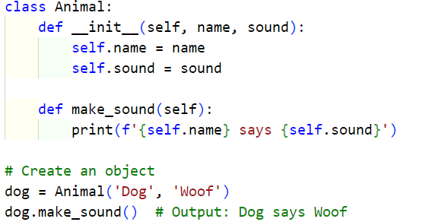
Classes and Objects
Syntax for defining a class and creating an object.

Slide 8
Attributes and Methods
Attributes: Variables that belong to the object or class.
Methods: Functions that belong to the class.
Instance Attributes vs. Class Attributes with examples.

Slide 9
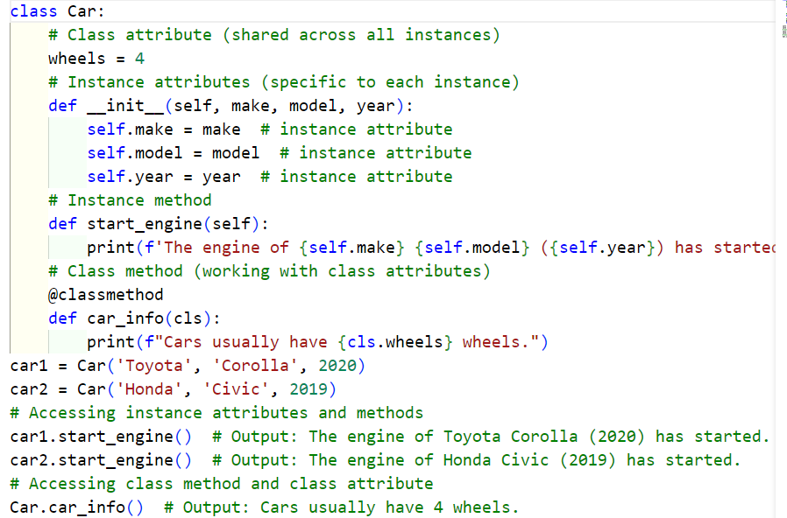
Instance Attributes vs. Class Attributes

Slide 10
Hands-on Exercise: Creating Your First Class
Create a Car class with attributes like make, model, and year.
Add a method start_engine that prints "Engine started."

Slide 11
Object Representation
__repr__(self): Should return an unambiguous string representation of the object, ideally one that could be used to recreate the object.
__str__(self): Returns a user-friendly string representation of the object.

Slide 12
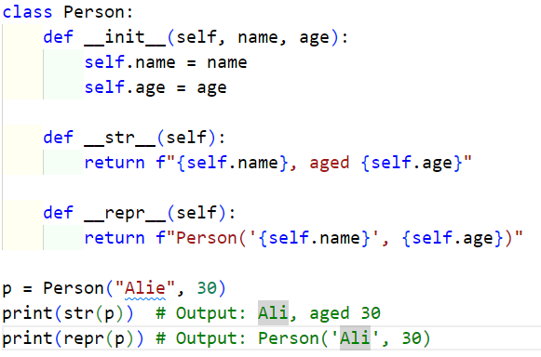
Object Representation

Slide 13
Comparison Magic Methods
__eq__(self, other): Equality (==).
__ne__(self, other): Inequality (!=).
__lt__(self, other): Less than (<).
__le__(self, other): Less than or equal to (<=).
__gt__(self, other): Greater than (>).
__ge__(self, other): Greater than or equal to (>=)

Slide 14
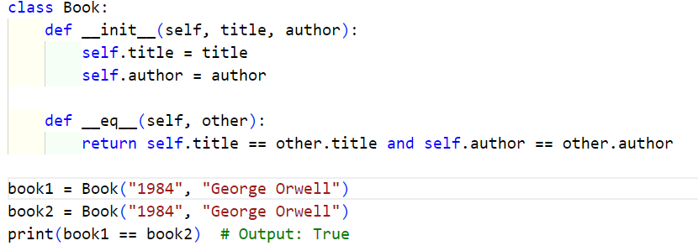
Comparison Magic Methods

Slide 15
Inheritance
What is inheritance?
Benefits of code reusability.

Slide 16
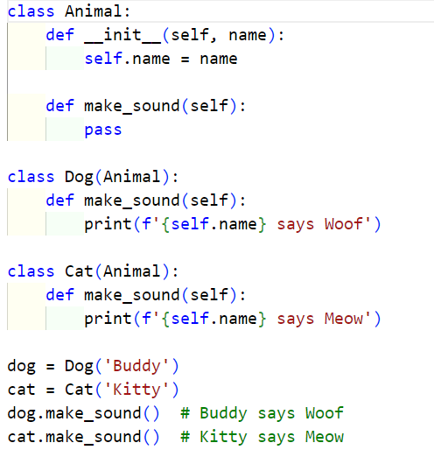
Inheritance – Example

Slide 17
Hands-on Exercise: Inheritance
Extend the Car class to create a ElectricCar class that adds battery-specific attributes

Slide 18
Encapsulation
Protecting data by limiting access to methods.
Use of private (_ or __) attributes.

Slide 19
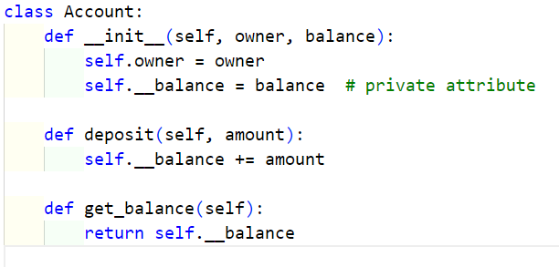
Encapsulation

Slide 20
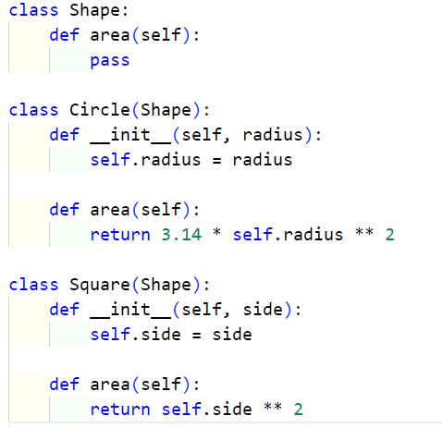
Polymorphism
Ability to use a common interface for multiple types.

Slide 21
Hands-on Exercise: Polymorphism
Create a parent class Shape and derived classes Rectangle and Triangle with their own area() method.

Slide 22

Questions ?

